Slide 1

Shell Programming Lecture # 5
Dr. Muhammad Bilal Qureshi
m.qureshi@centralasian.uz
Central Asian University, Tashkent, Uzbekistan

Slide 2
Source
Textbook:
Beginning Linux Programming 4th Edition by Neil Metthew

Slide 3

Contents
Environment & Parameter Variables (recap)
Example of $@ vs $*
Parameter and Environment Variables Use in Script
Conditions and Program Control
If condition constructs, else if
For, while and until loop construct
Case construct
Lists
Simple list

Slide 4
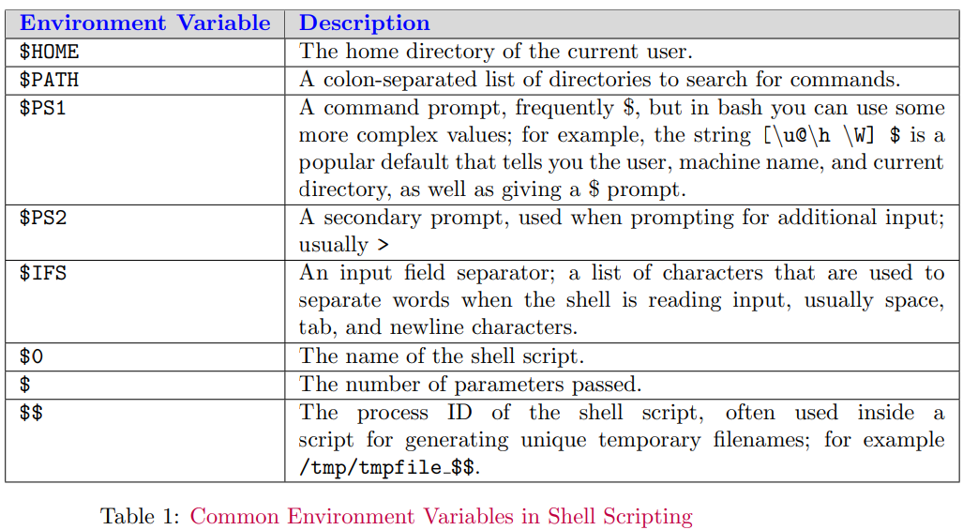
Environment Variables
When a shell script starts, some variables are initialized from values in the environment. These are normally capitalized to distinguish them from user-defined (shell) variables in scripts, which are conventionally lowercase.
Notes:
export PS1='[\u@\h \W]$ '
[john@server Documents]$

Slide 5
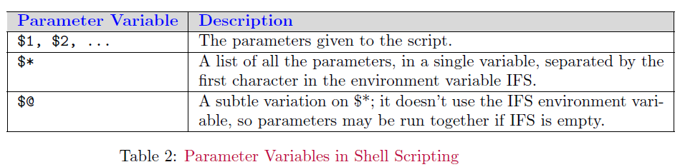
Parameter Variables
If your script is invoked with parameters, some additional variables are created. Even if no parameters are passed, the preceding environment variable $# still exists but has a value of 0. The parameter variables are listed in the following table.

Slide 6
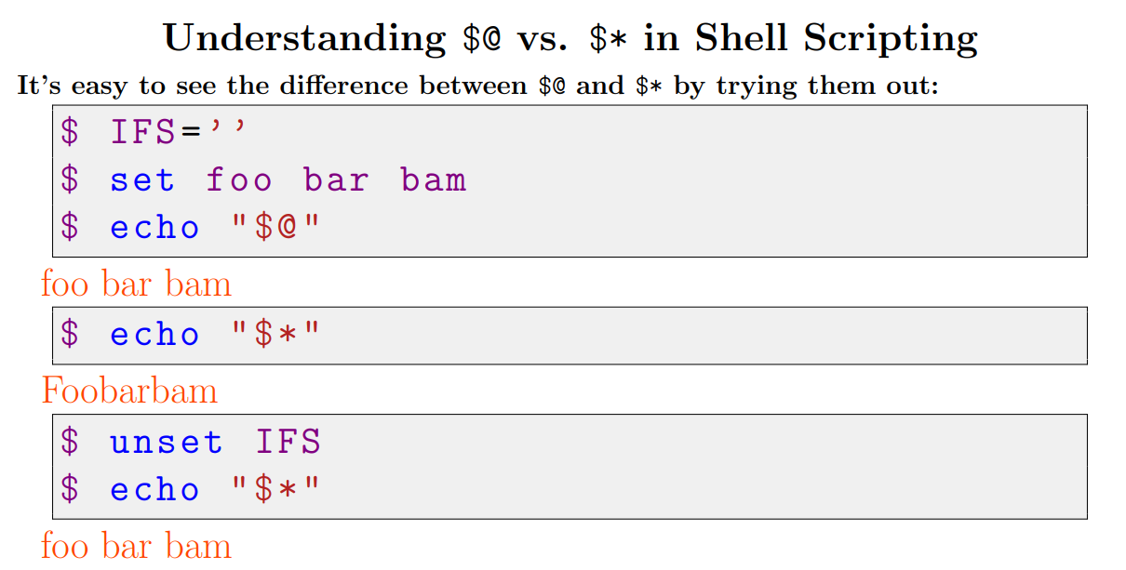
Notes:
As you can see, within double quotes, $@ expands the positional parameters as separate fields, regardless of the IFS value. In general, if you want access to the parameters, $@ is the sensible choice.

Slide 7
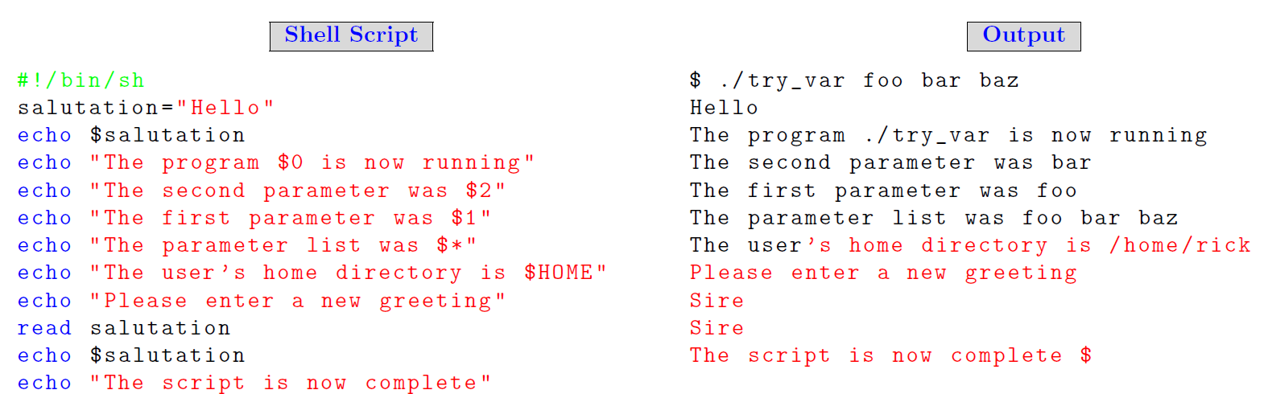
Parameter and Environment Variables
The following script demonstrates some simple variable manipulation. Once you’ve typed the script and saved it as try_var, don’t forget to make it executable with chmod +x try_var.

Slide 8
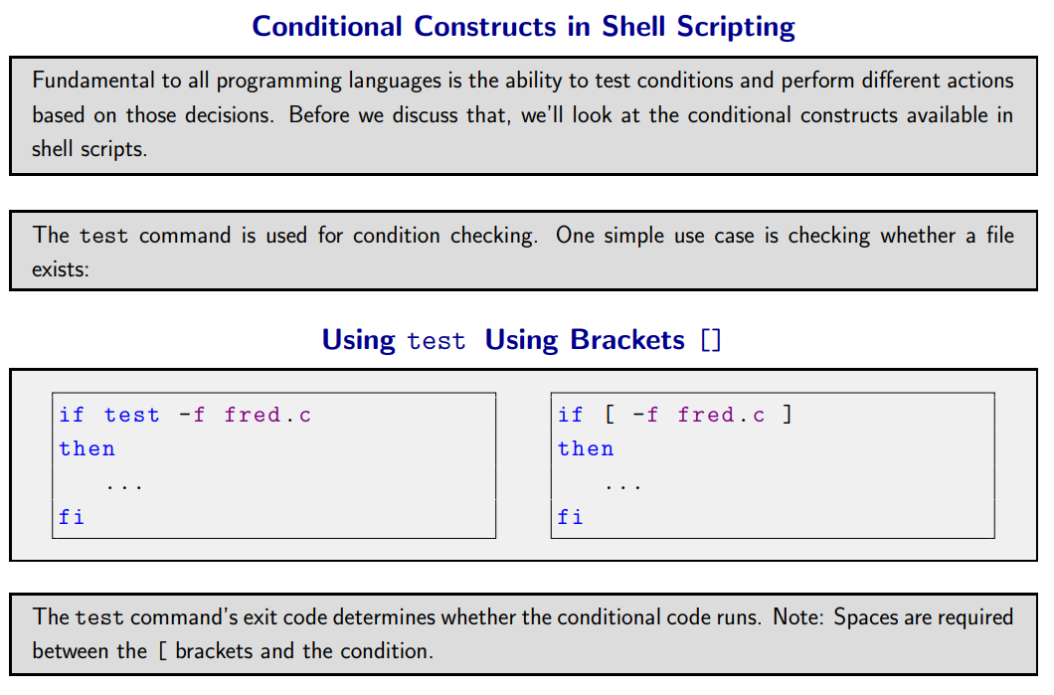

Slide 9
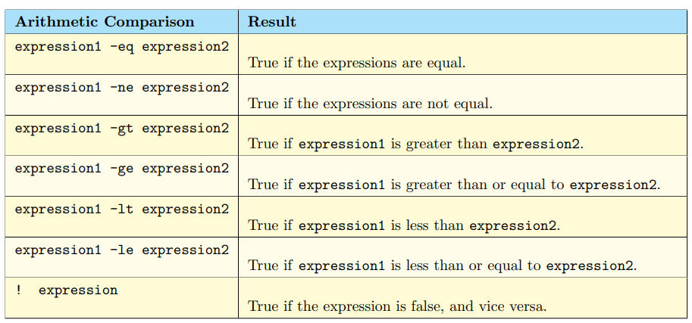
Arithmetic Comparison

Slide 10
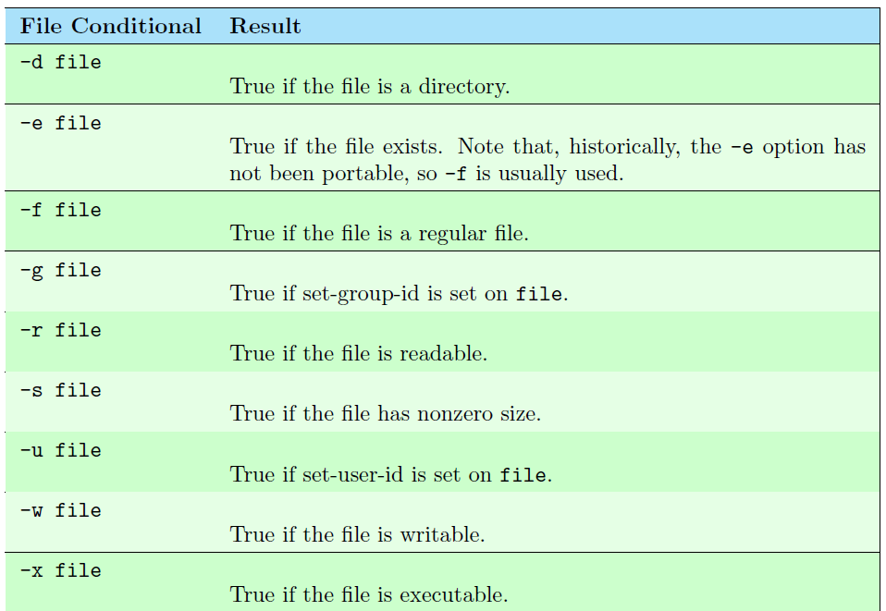
File Condition
Notes:
Chmod g+s filename

Slide 11
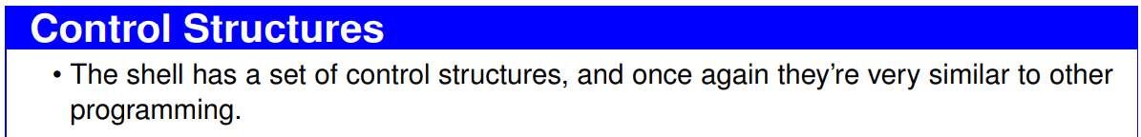
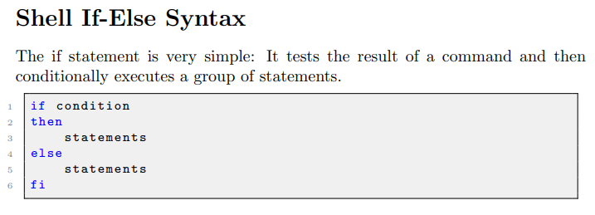

Slide 12
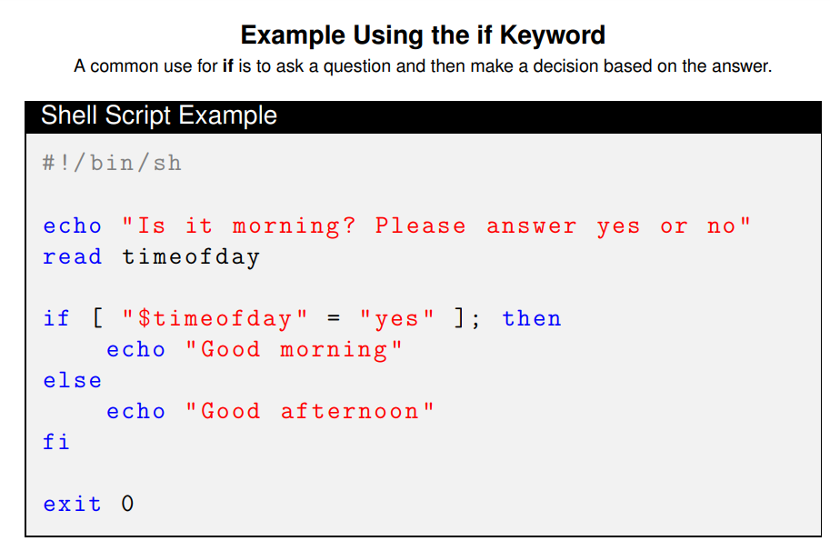
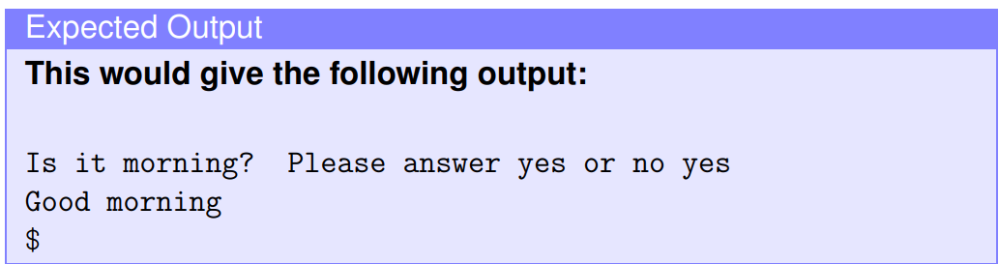

Slide 13
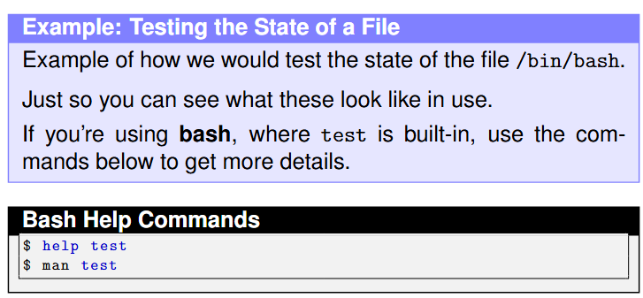
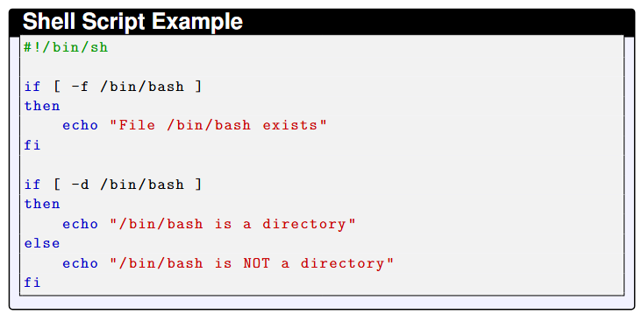

Slide 14
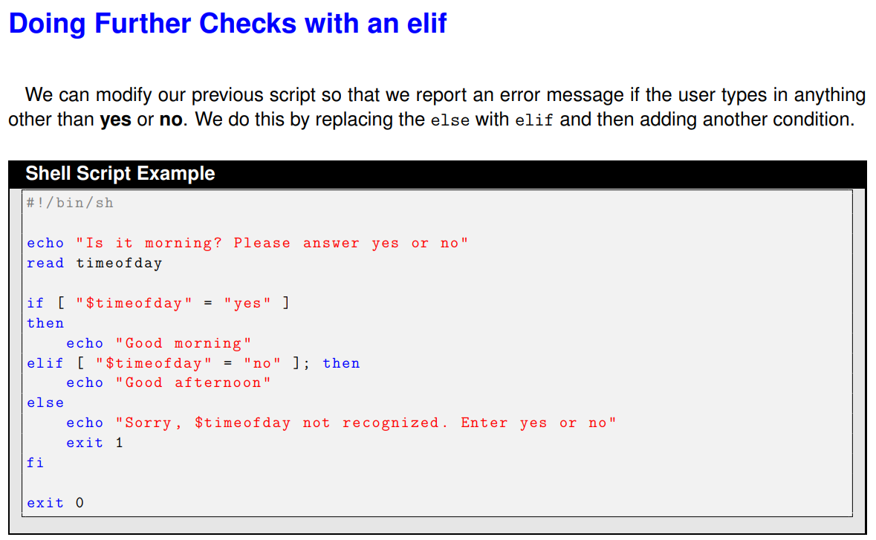

Slide 15
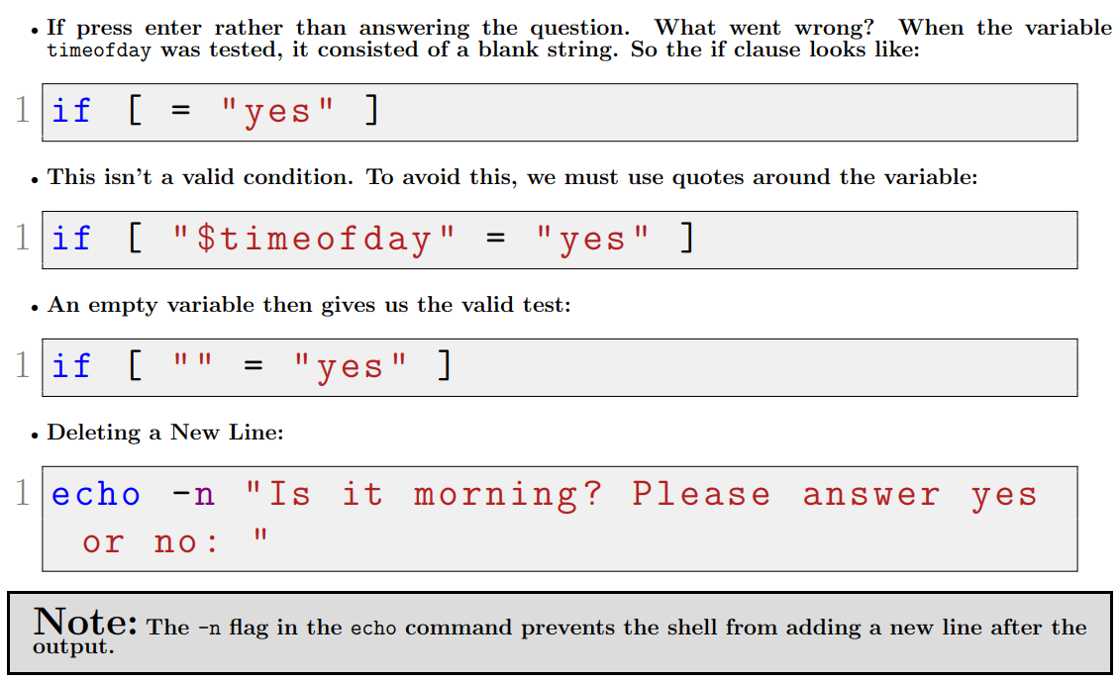
A problem with Variables

Slide 16
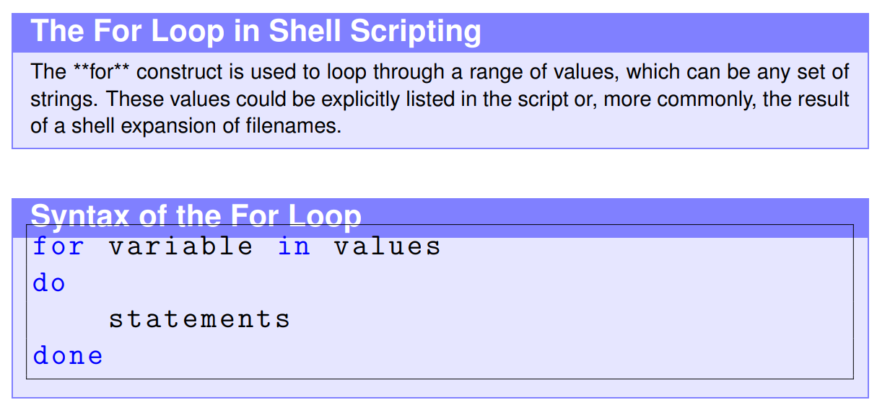
For loop

Slide 17
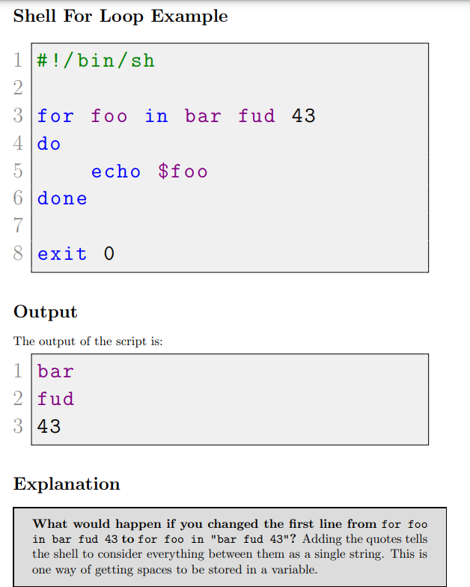
For Loop with Fixed Strings
Notes:
#!/bin/bash for i in {1..100} do echo $i done
for i in $(seq 1 100)
do
echo "$i“
done
#!/bin/sh for foo in 1 2 3 4 5 6 7 8 9 10 11 12 13 14 15 16 17 18 19 20
do
echo “here we go again”
done exit 0
Seq is a linux command

Slide 18
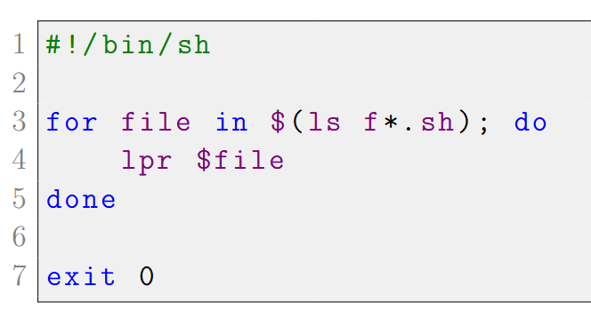
For Loop with Wildcard Extension
Imagine that you want to print all the script files starting with the letter f in the current directory, and you know that all your scripts end in .sh. You could do it like this:
Basically, the parameter list for the for command is provided by the output of the command enclosed in the $() sequence. The shell expands f*.sh to give the names of all the files matching this pattern

Slide 19
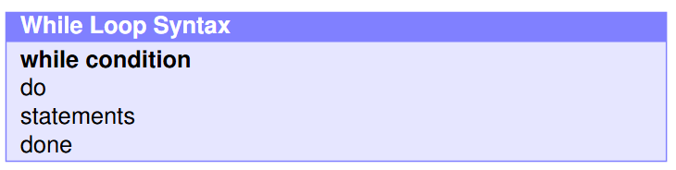
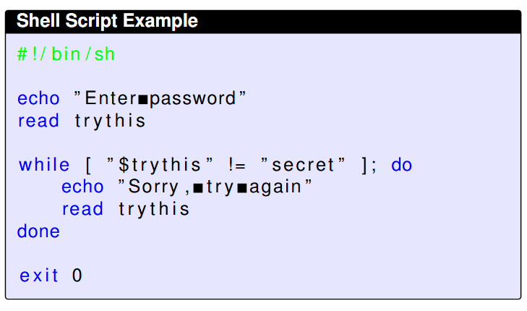
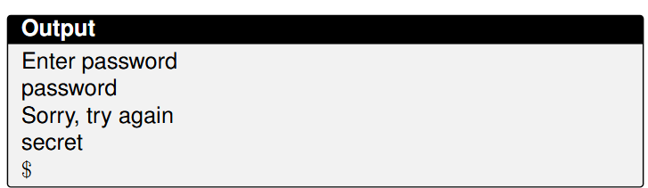
While Loop

Slide 20
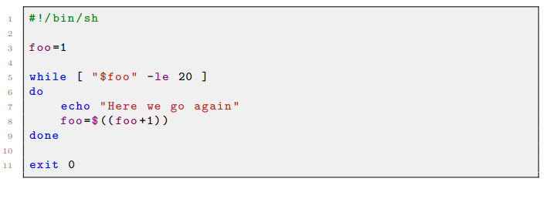
While Loop (cont..)
By combining the while construct with arithmetic substitution, we can execute a command a fixed number of times. This is less cumbersome than the for loop we saw earlier.
(($foo+1)) is used to perform arithmetic evaluation of the expression inside the braces, so foo is incremented each time around the loop.

Slide 21
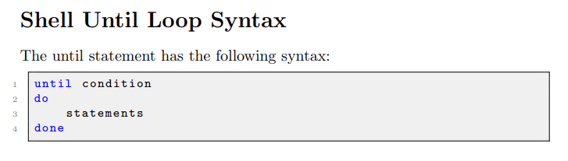
Until Loop
This is very similar to the while loop, but with the condition test reversed. In other words, the loop continues until the condition becomes true, not while the condition is true. The until statement fits naturally when we want to keep looping until something happens.

Slide 22
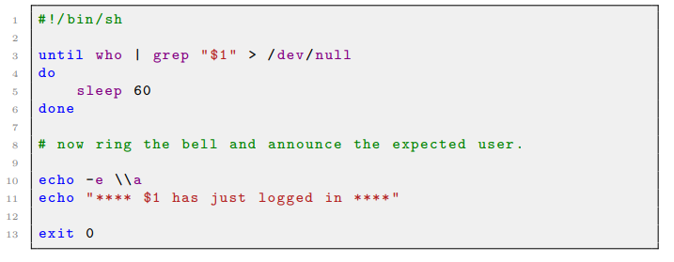
Until Loop (Cont..)
This line continuously runs the who command to check the currently logged-in users and pipes the output to grep to search for the username provided as an argument ("$1"). The output of grep is redirected to /dev/null, so no output is displayed. This line essentially waits until the specified user logs in.
echo -e \\a: This line produces a bell sound, which is an audible alert.
(-e enables backslash interpretation of the escape sequence)

Slide 23
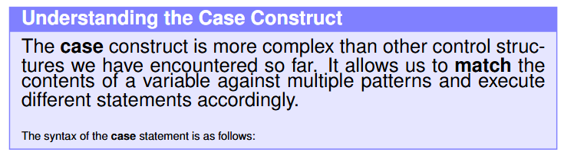
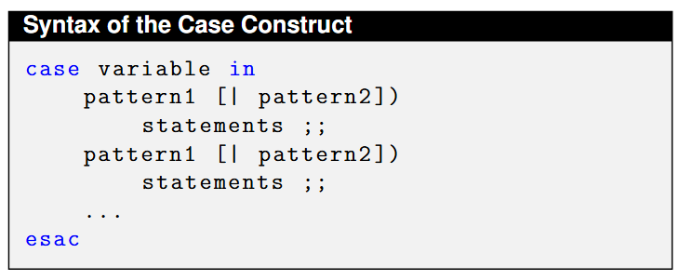
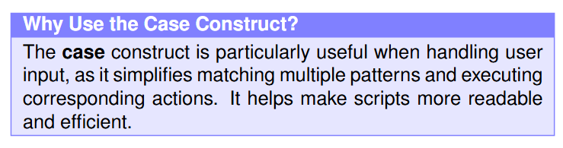
Case Construct

Slide 24
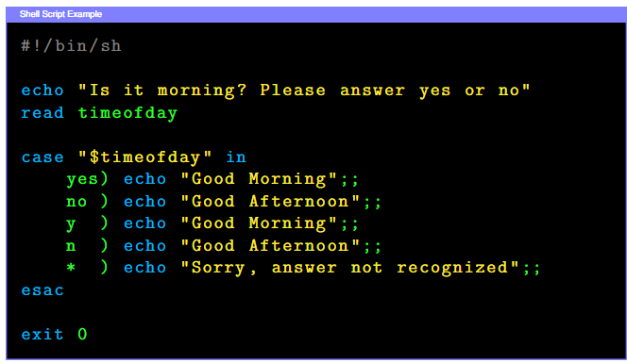
Case Construct (Cont..)
Be careful with the case construct if you are using wild cards such as ‘*’ in the pattern. The problem is that the first matching pattern will be taken, even if a later pattern matches more exactly.
Case I: User Input, We can write a new version of our input-testing script and, using the case construct, make it a little more selective and forgiving of unexpected input.
Notes:
How It Works:
When the case statement is executing, it takes the contents of timeofday and compares it to each string in turn. As soon as a string matches the input, the case command executes the code following the ) and finishes. The case command performs normal expansion on the strings that it’s using for comparison.

Slide 25
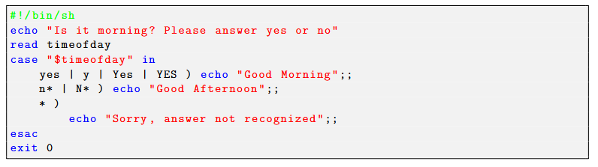
Case Construct (Cont..)
Case II:
Putting Patterns together the preceding case construction is clearly more elegant than the multiple if statement version, but by putting the patterns together, we can make a much cleaner version.
Notes:
How It Works: In this script, we used multiple strings in each entry of the case so that case tests several different strings for each possible statement. This makes the script both shorter and, with practice, easier to read. We also show how the * wildcard can be used, although this may match unintended patterns. For example, if the user enters never, this will be matched by n* and Good Afternoon will be displayed, which isn’t the intended behavior.

Slide 26
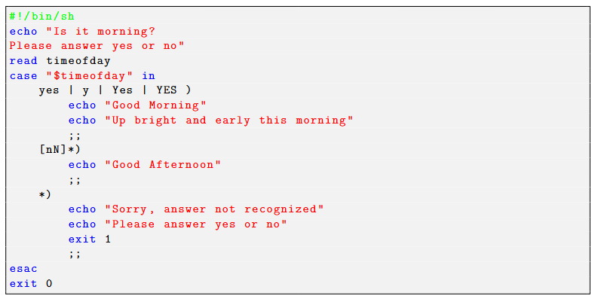
Case Construct (Cont..)
Case IIl:
Executing Multiple Statements Finally, to make the script reusable, we need to have a different exit value when the default pattern is used. We also add a set construct to show this in action.
Notes:
How It Works: To show a different way of pattern matching, we change the way in which the no case is matched. We also show how multiple statements can be executed for each pattern in the case statement. Notice that we’re careful to put the most explicit matches first and the most general match last. This is important because the case will execute the first match it finds, not the best match. If we put the *) first, it would always be matched, regardless of what was input

Slide 27
Case Construct (Cont..)
To make the case matching more powerful, we could use something like this:
[yY] | [Yy][Ee][Ss] )
This restricts the permitted letters while allowing a variety of answers and gives more control than the * wildcard.

Slide 28
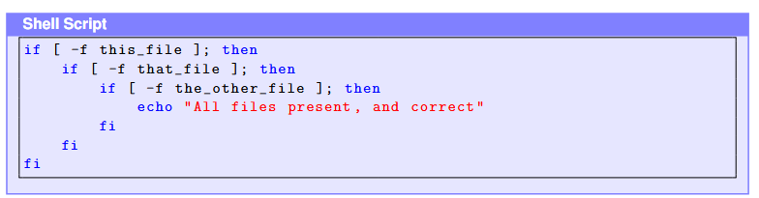
Lists
Sometimes we want to connect commands in a series. For instance, we may want several different conditions to be met before we execute a statement like:

Slide 29
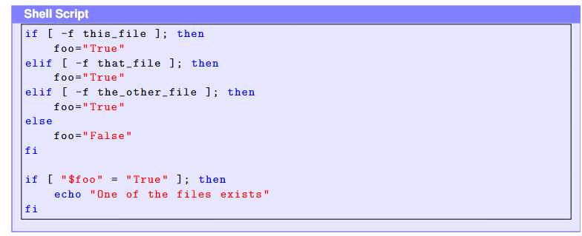
List (Cont..)
or you might want at least one of a series of conditions to be true:

Slide 30
Thank You
Questions?

